Slide 1
Coaches Manual

Slide 2
Coaches Manual Table of Contents
Introduction to the CFLLN 1
CFLLN Coaches Mission Statement 2
Transformational Coaching 3-7
Coaching Expectations 8-9
Parents 10-15
Culture Keepers 16-19
Team Equipment 20
Practices / Game Days 21
Umpiring Obligations 22
Evaluations, Player and Coach Development 23
League Rules / Rule Book 24-28
Field Locations 29-35
Other Coaching Tips / Resources 36-39

Slide 3
Introduction to CFLLN
From League President, Mike Pollard:
Our mission is very clear, we are here to develop our children into extraordinary citizens, and baseball is our means to that end. With a great complex facility, CFLLN is able to offer a variety of programs
designed around six (6) baseball fields. Our programs include our core baseball leagues Majors, AAA and AA and A, as well as an instructional Division for 4, 5 and 6 year olds. Our goal for 2012 is to improve
on our successful past with changes to help enhance your child’s Little League experience. This will be accomplished with the dedication of several individuals that are stepping up to form an exciting board
determined to continue to make CFLLN a solid organization.
Let’s start with 2012!
· We will be offering more opportunities for fundamental skills training seminars at the complex
· We are investigating workshops for managers to have opportunities to better their coaching techniques
· The league will offer a more affordable option for our instructional system to introduce young children to baseball
· We support the options of travel teams for children to extend their playing time and CFLLN continues to maintain the set schedules for players who would like to participate in such leagues and still take part in the Little League experience.
1

Slide 4
CFLLN Coaches Mission Statement
We coach boys and girls to become men and women of character, courage, loyalty, and empathy, who will lead, be responsible, and change the world for good.
2

Slide 5
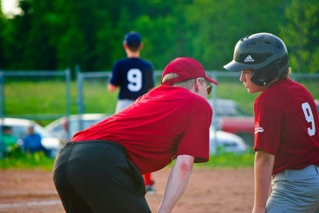
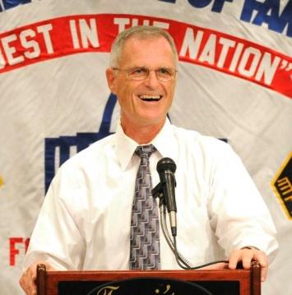
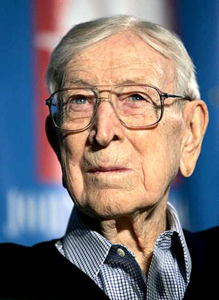
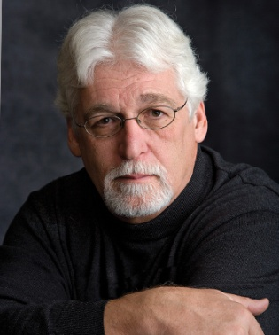
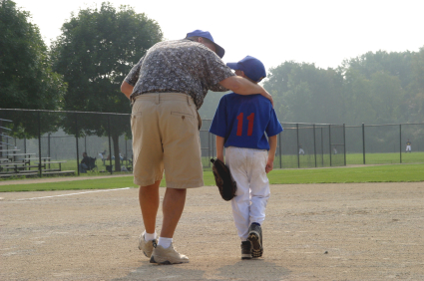
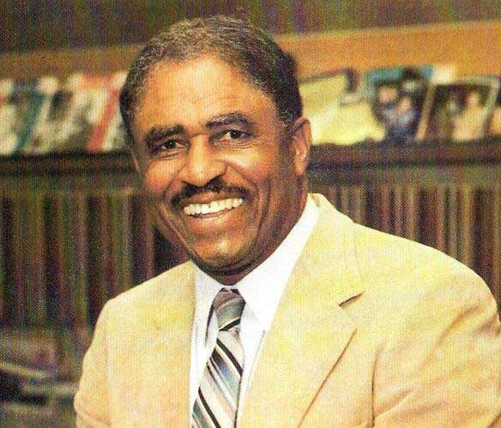
Outside of parenting, there might not be a more influential person than a COACH.
YOU?
3

Slide 6
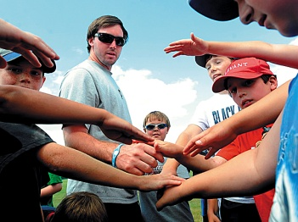
Sports can transform lives, but only with the help of Transformational Coaches
Transformational Coaches ask these questions:
Why do I Coach?
Why do I Coach the way that I do?
What does it feel like to be coached by me?
How do I define Success?
4

Slide 7
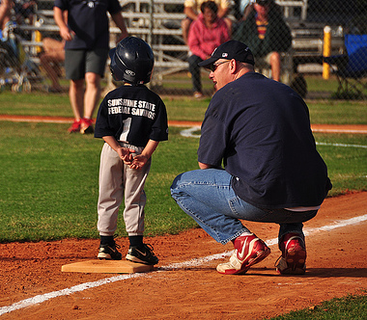
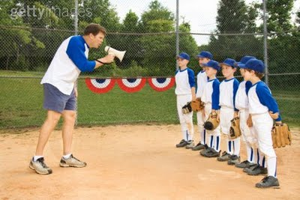
Transformational Coaching
#1
PLAYER
#2
TEAM
#3
COACH
Use their platform to make life change in their players
Transactional Coaching
#1
COACH
#2
TEAM
#3
PLAYER
Use their platform to center the focus around them
5

Slide 8
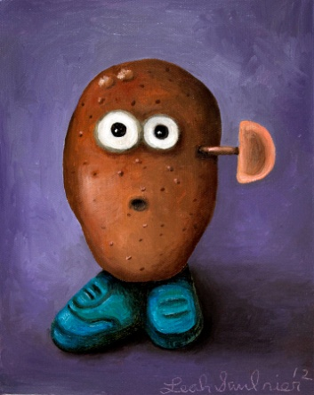
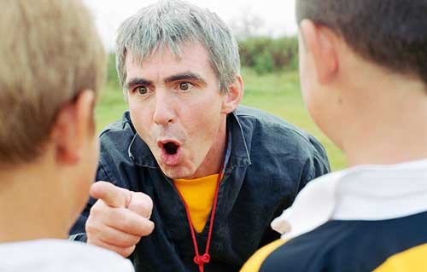
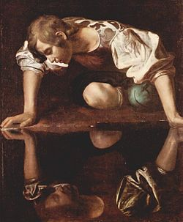
Transactional Coaching Styles
6

Slide 9
Coaching Resources & Reference Page
http://www.positivecoach.org/
http://www.coachforamerica.com
http://www.coaching4life.us/
http://www.littleleague.org
http://www.ripkenbaseball.com/
7

Slide 10
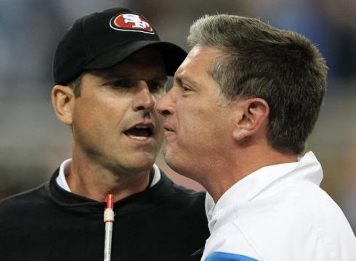
Coach to Coach Relations
Never argue during the game, in front of the players, or parents.
Handle all disagreements after the game in private with each other.
If a mediator needs to be involved, the league VP will step in.
8

Slide 11
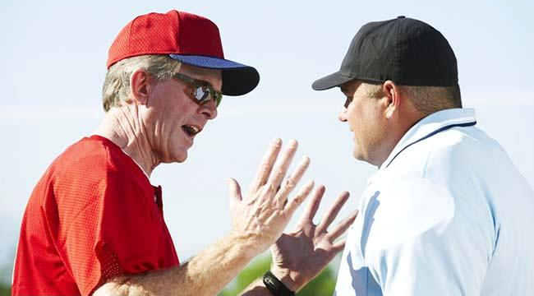
Coach to Umpire Relations
Never argue during the game, in front of the players, or parents.
These are volunteers. Treat them with respect.
Use a bad call to teach players life lessons.
If there’s a disagreement about a rule, grab the other coach and have a private conversation to resolve the disagreement.
9

Slide 12
Coach to Parents Relations
Great communication is always appreciated.
Talk to them as often as possible about their player.
Develop a “Mistake” Policy (For players, coaches, and umpires
Develop a “Cheering” Policy for your players and the other team’s players.
Get them involved.
10

Slide 13
Sample Parent/Guardian Meeting Agenda
WELCOME AND INTRODUCTIONS
Coach’s background as athlete, coach, parent, etc. “We’re going to be spending a lot of time together so let’s get to know each other”
Each person share their best, worst or funniest personal moment in sports
COACHING PHILOSOPHY
Our team values
Honoring the Game/ROOTS of Positive Play
Dealing with mistakes in competition/Team Mistake Ritual
Policy on playing time, missing practices, etc.
GOALS AND HOPES FOR THE SEASON
Coaches Goals & Hopes
Parent Goals & Hopes
LOGISTICS ABOUT THE SEASON
Practice schedule, Equipment, Uniforms
Game schedule
Phone, e-mail lists
ASK FOR VOLUNTEERS
Team Mom
Snacks
Rides
Score keeping
Culture Keeper
11

Slide 14
Sample Parent/Guardian Meeting Agenda
A pre-season parent meeting is a wise investment. People tend to live up to expectations if they know them. A meeting can help mold the behavior of your athletes’ parents. The most effective way to have your pre-season parent meeting is in a private setting (such as the home of one of the coaches or parents) where you can have the full attention of the group. If this is not possible, then the meeting could be scheduled before one of the first practices or games when the parents would need to be delivering their kids anyway.
Welcome & Introduction: Share how excited you are about the upcoming season and having their children on your team. Share some of your relevant background as an athlete, coach, parent, etc.
Coaching Philosophy: Share your values as a Double-Goal Coach. Give them the Parent Pledge document and talk through in detail. Ask for questions on each before you go on to the next. Ask for their support in building a team culture (“the way we do things here”) that will reinforce those principles. Ask a “what–if” question: “What if the official makes a bad call against our team? Will you be able to set a good example for the players and Honor the Game?” Because mistakes are such a motivational problem, share the Mistake Ritual you intend to use with your team and ask them to reinforce it from the sidelines. Share your policy on playing time, missing practice, etc. Future problems can be avoided by being clear now. If there are playing time rules in your league, specify them. If missing practice means less playing time, for example, let parents know that. Let them know when they can contact you (at work during the day, only in evenings, etc.)
Goals & Hopes for the Season: In addition to goals such as winning games, some goals you might want to consider:
• Every athlete will love the sport at least as much at the end of the season as at the beginning
• Every athlete’s skills and tactical knowledge of the sport will improve
• Every athlete will get chances to test himself/herself in game situations
• Every athlete will want to play the sport again next year
• The parents will enjoy the season as much as the athletes
Ask parents about their goals and hopes for the season. This may give insight into the players’ motivation. You don’t have to respond to everything right then – you can think about it and talk with parents later if they express goals that are inconsistent with your values.
Logistics: Make sure everyone has practice and game schedules. Hand out a phone/email list (or get
people to sign up on a list for distribution later). Talk about the facilities, practice and game locations, the rainout hotline. Make sure they understand what equipment their children will need, etc. Leave plenty of time for questions.
Asking for Volunteers: Your parent meeting is a good time to ask parents to volunteer
for any duties you need help with, such as: additional coaches, scorekeeper,
team mom, culture keeper, ect
12

Slide 15
Parent’s Code of Conduct
I understand and endorse the purpose of Cuyahoga Falls Little League North Baseball : to help boys become men and girls become women of character, courage, loyalty, and empathy who will lead, be responsible, and change the world for good.
I support the coaches by applauding behaviors in my child and teammates that demonstrate characteristics of integrity, empathy, sacrifice, and responsibility.
I acknowledge and appreciate every player’s growth towards maturity and efforts toward establishing stronger relationships with teammates, coaches, and themselves.
I affirm my child and teammates when good character, healthy sportsmanship, and other-centered behaviors are displayed. I will not only affirm athletic performance or a victory.
I serve as a role model for our players talking politely and acting courteously towards coaches, officials, other parents, visiting team parents, and spectators at practices, games, and meetings.
I model good sportsmanship. Acknowledge and applaud the efforts of team members and opponents. Accept defeat graciously by congratulating the members of the opposing team on a game well played. Support the team regardless of how much or how little my child plays or what the win-loss record is.
I encourage my child and teammates with positive statements, even when they make mistakes. At every practice they are growing physically and emotionally. At every practice they are learning moral and ethical lessons. At every practice they are developing character.
I refrain from boasting about my child’s accomplishments. When problems or questions arise, I have my child present the problem to the coach. This develops self-advocacy. After meeting with their coach, if the issue requires more clarity, I will contact the coach.
Because I am a parent with the power, position, and platform to make a positive difference in the lives of all players, I commit to this code of conduct. When failing to live up to these standards, I will allow for accountability and take responsibility for my actions.
Parent’s Signature Player’s Name Date
Copyright © 2011
Coach for America® • www.coachforamerica.com
InSideOut® Coaching
13

Slide 16
Player’s Code of Conduct
I accept responsibility for my behavior on and off the field. I understand that what I do and say affects my teammates, school, and other people either positively or negatively.
I lead courageously and live with integrity by speaking up against injustice and on behalf of others even when it is hard or unpopular.
I act with respect toward myself and the people and things around me including my parents, my coaches, my teammates, my teachers, my opponents, and the spectators.
I do not put people in boxes according to their race, gender, religion, neighborhood, sexual orientation or abilities. I judge people by the content of their character.
I act with empathy. I try to understand what is going on in the hearts and minds of others and what is causing those feelings so that I can be supportive and encouraging. I ask, “How can I help you?”
I serve as a role model at all times by talking politely and acting courteously toward coaches, teammates, opponents, officials, and spectators. I understand that it is a privilege to represent my family, school and community as a student-athlete.
I give 100% effort to practices, games, and events. I understand that effort demonstrates my commitment to the team and my respect for my coaches and teammates.
I display good sportsmanship. I acknowledge and applaud the efforts of others. I encourage my teammates with positive statements. I refrain from boasting to my teammates and ‘trash-talking’ to members of other teams. I accept defeat graciously by congratulating my opponents on a game well played.
Because I represent my family, school, and team, I abide by the policies, rules and guidelines of the school, team, and coaches.
Player’s Signature Print Player’s Name Date
Copyright © 2011
Coach for America® • www.coachforamerica.com
InSideOut® Coaching • 443-797-0144
14

Slide 17
Coach’s Code of Conduct
The purpose of my coaching is to: help boys become men and girls become women of empathy and integrity who will lead, be responsible, and change the world for good.
I am mindful to never shame a player, but to correct in an uplifting way. Affirmation!
I protect our players. I am big enough to build up, not tear down. Kids are getting attacked from many places that we don’t often see and of which we are not aware.
My job is to put players in a position where they can develop to their fullest potential through proper teaching and nurturing.
Each player is part of our family, deserves every chance to succeed and deserves the utmost respect.
Coaches can disagree in meetings but never in front of our players or anyone else outside of our family. Disagreements are saved for private meetings.
Our players are student-athletes and we are teacher-coaches. We hold ourselves accountable as teachers of young men and women and the lessons they need in order to navigate masculinity, femininity and life.
Parents are our partners. I strive to work with each family in helping their child succeed. “Every boy is a son, every girl a daughter to their mother and father.”
I use no profanity!
I know the difference between shaming and coaching. No screaming, shaming, swearing, or sarcasm.
I won’t be afraid to apologize! We all make mistakes. When mistakes are made publicly, I will apologize publicly; when mistakes are made personally, I will apologize personally.
We are nurturing successful people, not just successful athletes.
I treat all opposing coaches and their teams with honor deserving of true competitors.
I respect all referees, officials, and timekeepers. They are imperfect and trying their best just as we are.
Regardless of our wins and losses, we will be successful, if we carry out the above items.
Because I am a role model who has the power, position and platform to make a positive difference in the lives of my players, I commit to this code of conduct. When failing to live up to our standards I will allow for accountability and take responsibility for my actions.
Parent’s Signature Player’s Name Date
Copyright © 2011
Coach for America® www.coachforamerica.com
InSideOut® Coaching
15

Slide 18
Players that exemplify Character, Courage, Loyalty, and Empathy
Voted by the CFLLN board
Personalized letter sent to the player & parent
Picture of the player in the display case on the concession stand.
16

Slide 19
Game Ball Ceremony
Purpose is to recognize every player for actions of character, courage, loyalty, and empathy.
After every game, a coach will present a signed baseball to a player.
This ceremony should be in front of all the other players and the parents.
Make this a BIG event.
17

Slide 20
Character Board
Outdoor display case that would display :
Character Theme of the Week
Parent Dinner Discussion Questions
Player of the Week
18

Slide 21
Suggestion Box
Great organizations always want to get better and learn what people have to say and think.
19

